Slide 1

ENHANCING QUALITY IN INNOVATIVE
CONSUME-AWARE
HIGHER EDUCATION ABOUT CONSUMER AWARENESS

Slide 2



Slide 3
To create an interactive open education module for bachelor students in order to study consumers’ rights protection, especially in the European digital markets
PROJECT MAIN OBJECTIVE

Slide 4
PROJECT FEATURES
This project involves the implementation of a mobile application, an interactive platform and a book for universities concerning the EU Single Market including:
Consumer protection;
Institutions which address consumers right protection;
Legal rules concerning consumer rights protection on goods and services market;
Legal rules concerning consumer rights protection in the digital markets.

Slide 5
TARGET GROUPS
Direct target groups:
Consortium professors/lecturers and bachelor students.
Indirect target groups:
Higher Education Institutions’ authorities, employees and students who did not take part in project;
Institutions dealing with consumer protection rights issues;
European consumers.

Slide 6
The improvement of academic innovative teaching methods.
Transnational Meetings for teachers to enhance their knowledge.
Cooperation in multinational teams foster appropriate skills development for teachers who create consortium.
It increases the effectiveness of education.
WHY TO USE IT

Slide 7
It gives the opportunity to explore the potential of digital technologies, ICT to improve education and training systems.
The creation of framework for consumer specialist knowledge transfer through creating an interactive educative platform.
WHY TO USE IT

Slide 8
THE PROJECT INNOVATIVE INPUT
The improvement of the quality of higher education;
The enhancement of the learners’ competences;
The establishment of a uniform system of innovative education;
The creation of the European model for academic people

Slide 9
THE PROJECT OUTCOMES
Learning platform: consume-aware.eu
Interactive teaching materials:
video, lectures, case studies, quiz ,guides,
BOOK : Enhancing Consumers Awareness
Mobile Application: quiz game

Slide 10
BOOK
Published in June, 2019
Placet, Publishing House

Slide 11
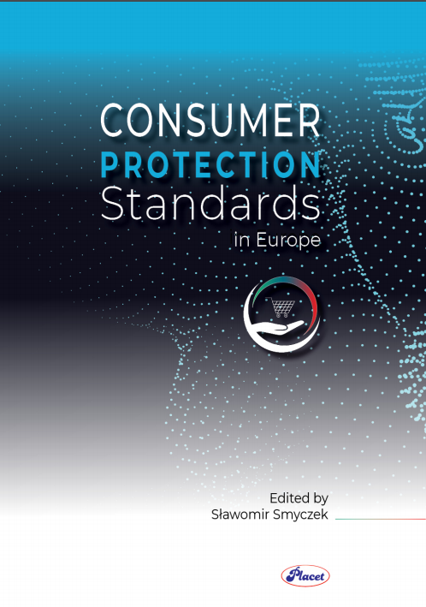
BOOK
https://depot.ceon.pl/bitstream/handle/123456789/16996/Consumer_protection.pdf?sequence=1&isAllowed=y

Slide 12
BOOK – Features and goals
Theoretical background on the study of the
consumers’ protection: rights, risks and solutions.
The analysis and characteristics of the consumers in the European traditional and e-markets;
The identification of the consumer’s rights;
The identification and characteristics of the European institutions which provide a practical insight into the consumer’s protection in the European Single Market.

Slide 13
BOOK – Features and goals
To characterize the consumer’s protection models and to identify possible amendments which would enhance the quality of protection mechanisms within the European Union;
To enhance cross-country cooperation;
To contribute to an advanced international dialogue by mutual discussions and exchange of opinions and expertise.

Slide 14
E-BOOK

Slide 15
Introductory articles about all the important key concepts that consumers should acquire;
Interactive case studies;
A short test after each case study concerning the understanding of the particular topic.
Structure:

Slide 16
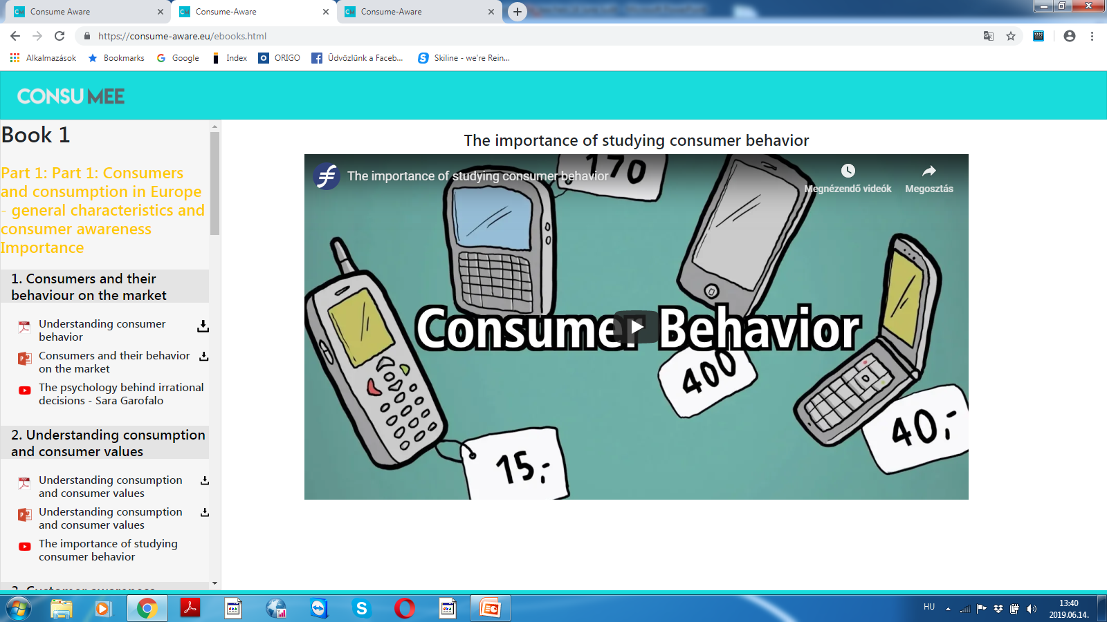
Video

Slide 17
MOBILE APPLICATION
An innovative tool used within the learning process as a useful solution for all consumers within the European Union

Slide 18
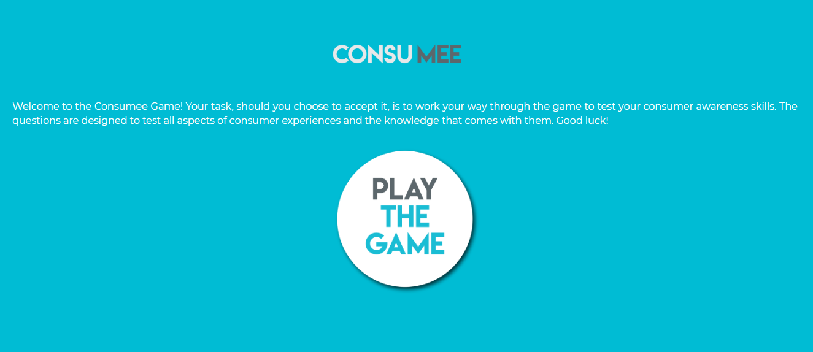
MOBILE APPLICATION

Slide 19
MOBILE APPLICATION
This application gives the possibility to check the actual customer awareness level. It also plays an educational role in teaching students, customers and individuals about their rights on the market. Thanks to this application, their consumer awareness knowledge could be developed. Customer Aware App can guarantee excellent education through entertainment.

Slide 20
Specialists in consumer and marketing topics, international business and ICT, with extensive expertise in transnational projects.
Each partner possesses country specific experiences and is able to contribute with country specific knowledge and best practices.
PROJECT PARTNERS

Slide 21
8
INTERNATIONAL PARTNERS
IN EUROPE

Slide 22








MEET OUR PARTNERS

Slide 23




Howest,University College West Flanders, Belgium – digital marketing, Consumer and Internet Law and Cyber Security
Budapest Business School, Hungary – IT skills
Isik University, Turkey – e-learning
Université Savoie Mont Blanc, France – consumer research, quantitative and qualitative market research
PROJECT PARTNERS AND THEIR EXPERTISE

Slide 24
Howest,University College West Flanders, Belgium – digital marketing, Consumer and Internet Law and Cyber Security
Budapest Business School, Hungary – IT skills, business ethics and consumer behaviour
Isik University, Turkey – e-learning
Université Savoie Mont Blanc, France – consumer research, quantitative and qualitative market research
PROJECT PARTNERS AND THEIR EXPERTISE

Slide 25






PROJECT DURATION AND STAGES
Duration: 2017-2019
Transnational meetings:
2016:
2017:
2018:
2019:
University of Economics, Katowice, Poland- initiation of the project,
Budapest Business School, Budapest, Hungary and University of Applied Sciences, Seinajoki, Finland,
Università degli Studi di Trento, Trento, Italy and Université Savoie Mont Blanc, France,
Howest,University College West Flanders, Belgium.

Slide 26
Distribution of tasks per partner;
Contents of the BOOK and E-BOOK;
Intensive Programmes: testing the mobile application on target groups;
Design of the project assessment survey;
Design of the course and teachers’ assessment survey;
Design of the course syllabus.
PROJECT ACTIVITIES

Slide 27
Collection of case-studies, video materials, quizzes for the Mobile Application;
Mobile Application guide of good practices;
Project promotion presentation;
Project dissemination presentation (formative and summative);
Project writing guide and platform.
PROJECT ACTIVITIES

Slide 28
THE PROJECT’S MOST IMPORTANT BENEFIT
It increases internationalization by cooperation with European partners

Slide 29
PROJECT BENEFITS
Promotes good practice examples on lifelong learning in Europe;
Promotes digital skills as a major asset in personal and professional growth in modern Europe;
Educates future specialists on the issue of e-consumers’ rights and protection;
Enhances the integration as well as the development of networking and cooperation between the European Universities.

Slide 30
PROJECT BENEFITS
Promotes modern technologies as a powerful tool for teaching;
Offers appropriate recognition for both students and teachers after the Intensive Programmes;
Offers a space of good practice, experience and know-how exchange as well as networking and communication between the best European specialists;
Offers a model of teaching and learning using advanced technology.

Slide 31
PROJECT BENEFICIARIES
Students and teachers from the European Higher Education Institutions
Consumers from the European Union (estimated number of almost half billion)
Policy makers on regional, local, national and EU level
The European Commission
Enterprises
Media

Slide 32
PROJECT DISSEMINATION
Formative dissemination:
Media press releases
Newsletter
Links promoting the project ongoing activities on each participating university website
Round tables with peer fellow teachers and students from the home university
Project platform
Social media
Leaflets, posters

Slide 33
PROJECT DISSEMINATION
Summative dissemination:
International conferences
Workshops
Round tables
Integration of the BOOK,
E-BOOK and MOBILE APPLICATION in the curriculum of each participating university
DG SANCO website
Social media
Articles
Interviews

Slide 34
Provides a modern approach of teaching and learning using advanced technology;
Provides high quality materials and a rich virtual learning environment;
Educates future specialists on the issue of e-consumers’ rights and protection;
Stimulates the integration, the internationalization and the development of cooperation among the European Universities.
PROJECT IMPACT

Slide 35
THANK YOU

